Slide 1

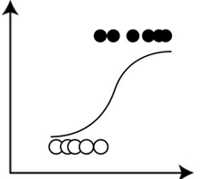
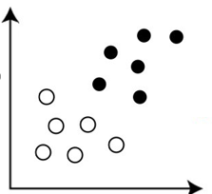

Class 10 – Logistic Regression
Prof. Pedram Jahangiry
Notes:
Logistic regression is a regression model that is mostly used for classification.
The output of the model are probabilities. For example, what are probabilities of Default vs Not. Pass vs not, buy vs sell, COVID + or not or any other binary outcome.
Then you come up with a threshold (50% or if you want to be more conservative a lower threshold) to make predictions for classification.

Slide 2
Road map
ML Algorithm
Supervised
Regression
Classification
Unsupervised
Dimensionality Reduction
Clustering
Principle Component Analysis (PCA)
K-Mean
Hierarchical
Linear / Polynomial
KNN
SVR
Tree-based Regression models
Logistic regression
KNN
SVC
Tree-based Classification models
Penalized regression

Slide 3
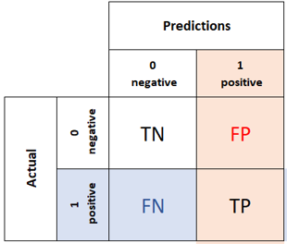
Topics
Part I
Linear probability model (LPM) vs Logistic regression
Sigmoid function
Logistic regression
Part II
Classification performance metrics
Accuracy
Precision
Recall
F1 score
MMC
ROC and AUC
Notes:
We will start with the most basic and intuitive model (LPM). Then we talk about its caveats and discuss why we need to transform that function.
Then we talk about Sigmoid function which is a monotone mapping basically and we will see how logistic regression is built using sigmoid function.
In part II, now that we have a classification model in hand, we need to see what are the most common performance metrics for classification.
At the heart of all the performance metrics, there is a matrix called confusion matrix which summarize model’s misclassifications. In general, if TN and TP are large and FP and FN are small it is good.
However, what is large what is small, we need to come up with relative measures and that why we play around with proportion tables.

Slide 4
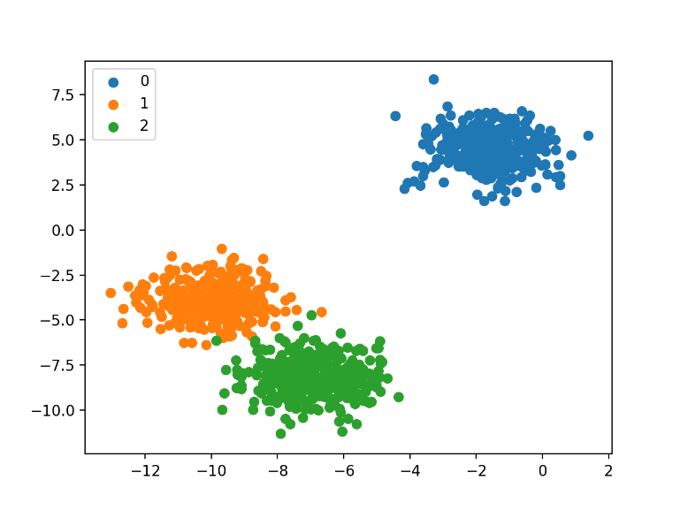
Classification
Qualitative variables can be either nominal or ordinal.
Qualitative variables are often referred to as categorical.
Classification is the process of predicting categorical variables.
Classification problems are quite common, perhaps even more than regression problems.
Examples:
Financial instrument tranches (investment grade or junk)
Online transactions (fraudulent or not)
Loan application (approved or denied)
Credit card default (default or not)
Car insurance customers (high, medium, low risk)
Notes:
Now let’s talk about classification itself. In classification problems, we are dealing with qualitative variables.
Qualitative variables can be either nominal (gender, race, .. ) or ordinal (credit tranches, GDP growth high medium low etc. ranking matters but magnitude doesn’t make any sense).
They are referred to as categorical because they fit data into categories.
Tranches are pieces of a pooled collection of securities, usually debt instruments, that are split up by risk or other characteristics in order to be marketable to different investors.
Logistic regression is widely used for 2 class classification.
For 3 classes and more, we can do multiple-class logistic or multinomial logit or softmax regression and etc. the idea is breaking down the multiple class to multiple binary classes.

Slide 5
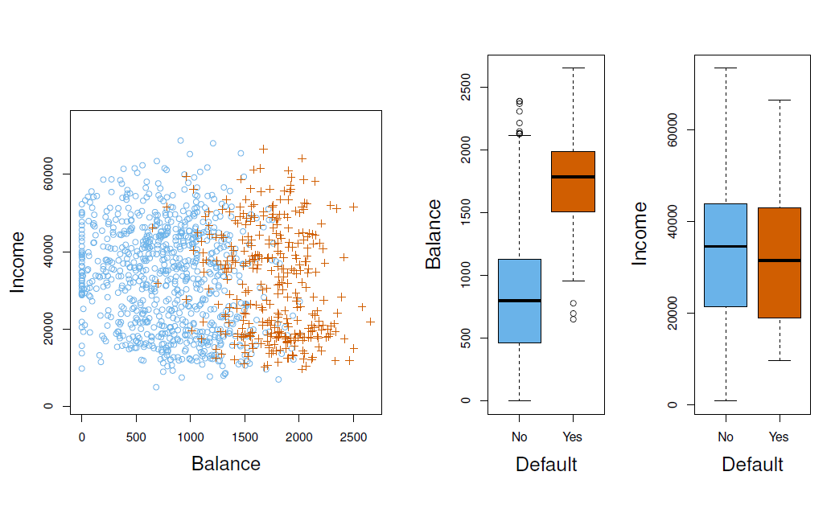
Credit card default example
Goal: Build a classifier that performs well in both train and test set.
Notes:
This example is from ISLR textbook.
Simulated data, 10,000 observation. 300 default. The blue circles are subset of no defaults.
These are monthly credit card balance and monthly income.
The goal is to build a classifier.
It seems that income vs default is all over the place. People with either high or low income may default. But for monthly balance the story is different.
Draw different decision boundaries on the board.

Slide 6
Part I
Logistic Regression

Slide 7
Linear Probability Model (LPM) vs Logistic Regression
Starting with simple LPM : $y=β_{0}+β_{1}bal+ε$ where, $Y=1$ for default and 0 otherwise.
$E\left(Y | bal\right)=\sum{P\left(y_{i} | bal\right). y_{i}}=\operatorname{Pr}\left(Y=1 | bal\right)=P\left(x\right)=β_{0}+β_{1}bal$
It seems that simple regression is perfect for this task,
But what are the caveats?
Notes:
This beta bal can be any number from – inf to + inf but our output must be between 0 and 1
What are other caveats of LPM? Heteroskedastic by construction.
The orange marks are the response either 0 or 1. LPM is not a good fit as you see.
What do we need? Some sort of transformation that take this line and restrict it between zero and one. We need a monotone mapping function.

Slide 8
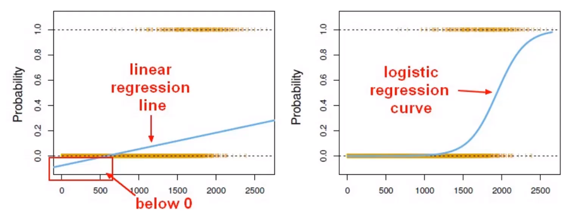
Linear Probability Model (LPM) vs Logistic Regression
What else? What if the data set is imbalanced?
Notes:
This beta bal can be any number from – inf to + inf but our output must be between 0 and 1
What are other caveats of LPM? Heteroskedastic by construction.
The orange marks are the response either 0 or 1. LPM is not a good fit as you see.
What do we need? Some sort of transformation that take this line and restrict it between zero and one. We need a monotone mapping function.

Slide 9
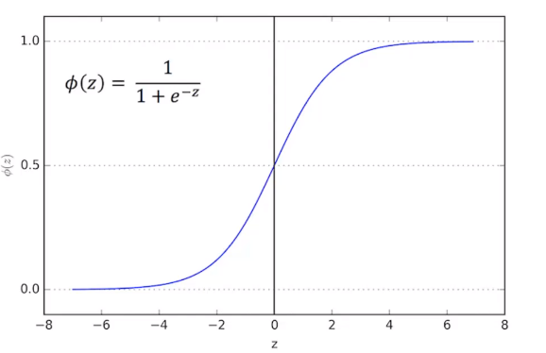
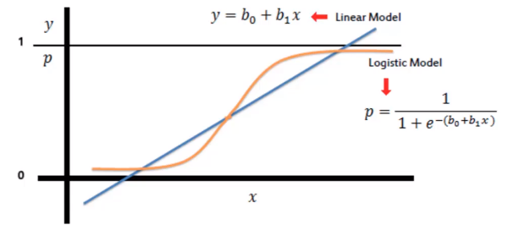
Sigmoid Function
We need a monotone mapping function that has a range of [0,1]
Notes:
P is the probability of default. Then we can classify the outcome. For example, if p>0.5 call it default. If you want to become more conservative, you do p>0.2.
More formal notation, p is the functional form for our f^(x). And we use WX+b for weights and etc.

Slide 10

Logistic Regression (Model)
$f_{w,b}\left(X\right)= \frac{1}{1+e^{−\left(WX+b\right)}}$
The model:
In case of two classes, $f_{w,b}\left(X\right)=\operatorname{Pr}\left(Y=1 | x\right)=p(x)$.
A bit of rearrangement gives
This monotone transformation is called the log odds or logit transformation of $p(x)$.
Logistic regression ensures that our estimates always lie between 0 and 1
$Log\left(\frac{p\left(X\right)}{1−p\left(x\right)}\right)=WX+b$
Notes:
We are restricting our f to be between 0 and 1. is it parametric or non-parametric?
Side note: If you use CDF of normal instead of sigmoid, you will get Probit model instead of logit.
By log we always mean natural log.

Slide 11
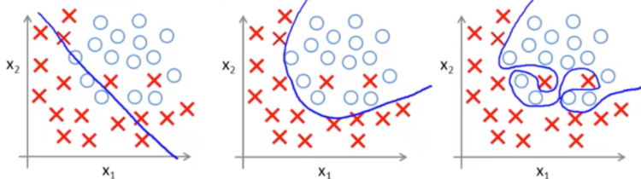
Logistic regression fit (Decision boundary)
Depending on how we define $WX+b,$we can get any of the following fits from logistic regression classifier.
Notes:
Here we can talk about logistic lasso and ridge and etc.
Logistic regression itself is a linear model. However, the fit can be either linear or non-linear.
Logistic regression is considered a generalized linear model because the outcome always depends on the sum of the inputs and parameters. Or in other words, the output cannot depend on the product (or quotient, etc.) of its parameters!
https://sebastianraschka.com/faq/docs/logistic_regression_linear.html#:~:text=The%20short%20answer%20is%3A%20Logistic,of%20its%20parameters!
For much more complicated decision boundaries, non-parametric methods like KNN works better.

Slide 12


Logistic Regression (Maximum Likelihood)
In logistic regression, instead of minimizing the average loss, we maximize the likelihood of the training data according to our model. This is called maximum likelihood estimation.
What is the likelihood function?
The likelihood function describes the joint probability of the observed data as a function of the parameters of the model.
$$L=0.9∗0.8 ∗\left(1−0.75\right)∗\left(1−0.2\right)=0.144$$
$$L=0.85∗0.6 ∗\left(1−0.4\right)∗\left(1−0.2\right)=0.244$$
Notes:
Simply put What is the probability that the data is coming from this model?

Slide 13
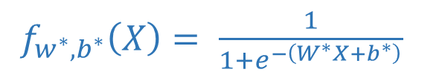
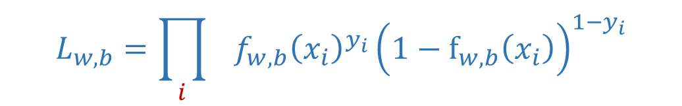
Logistic Regression (Maximum Likelihood)
MLE in action!
$f_{w^{∗},b^{∗}}\left(X\right)= \frac{1}{1+e^{−\left(W^{∗}X+b^{∗}\right)}}$
$$L_{w,b}=\prod_{i}{{ f}_{w,b}{\left(x_{i}\right)}^{y_{i}}{\left(1−f_{w,b}\left(x_{i}\right)\right)}^{1−y_{i}}}$$
Notes:
Now let’s see how does the machine learn to classify target variable by using logistic regression (what happens when you type (model.fit(X_train, y_train)) in Python. Remember, it all boils down to the objective function.
This ugly formula is nothing but multiplications of probability of default * no default. Think of balance example and draw a graph on whiteboard. This is the shifting S curve part from the video. We are trying to find beta_hats such that the prob of observing true values is maxed. Getting as close as possible to 1 and 0 on the graph.

Slide 14



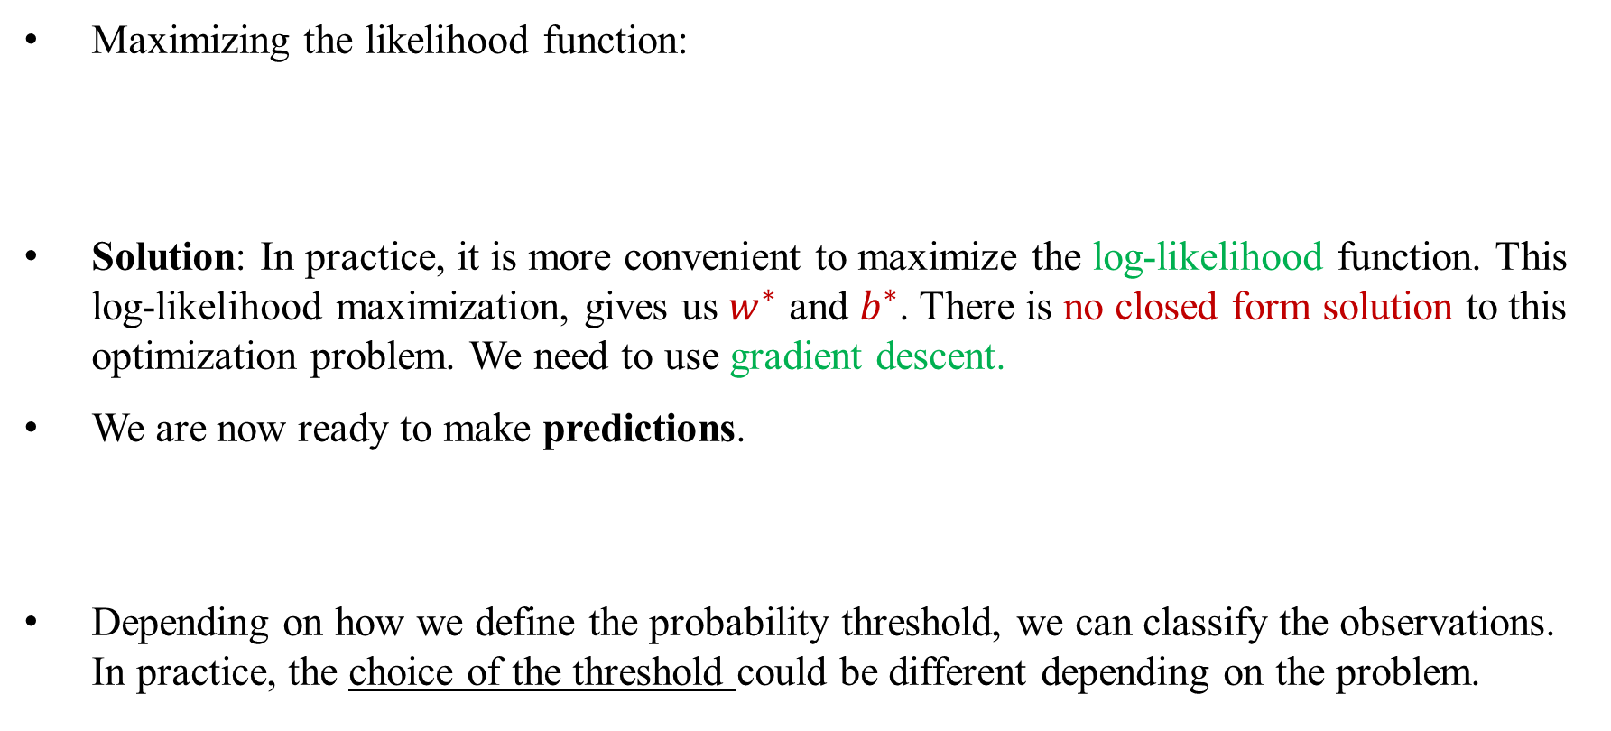
Logistic Regression (Objective function)
Maximizing the likelihood function:
Solution: In practice, it is more convenient to maximize the log-likelihood function. This log-likelihood maximization, gives us $w^{∗}$ and $b^{∗}$. There is no closed form solution to this optimization problem. We need to use gradient descent.
We are now ready to make predictions.
Depending on how we define the probability threshold, we can classify the observations. In practice, the choice of the threshold could be different depending on the problem.
${Max \{L}_{w,b}=\prod_{i}{{ f}_{w,b}{\left(x_{i}\right)}^{y_{i}}{\left(1−f_{w,b}\left(x_{i}\right)\right)}^{1−y_{i}}} \}$
$f_{w^{∗},b^{∗}}\left(X\right)= \frac{1}{1+e^{−\left(W^{∗}X+b^{∗}\right)}}$
Notes:
If you plug numbers for x in the model p(x), then you get the probability of default. This is the model.predict part.
There is no closed form solution because the betas show up as very non linear form in the objective function.
Different threshold:
Covid test results (lower threshold) to make sure that you are minimizing the false negatives. (you want to be conservative)
Spam detection (high threshold) to make sure that you are minimizing false positives. (you don’t want the email of your best friend go directly to spam folder!)

Slide 15
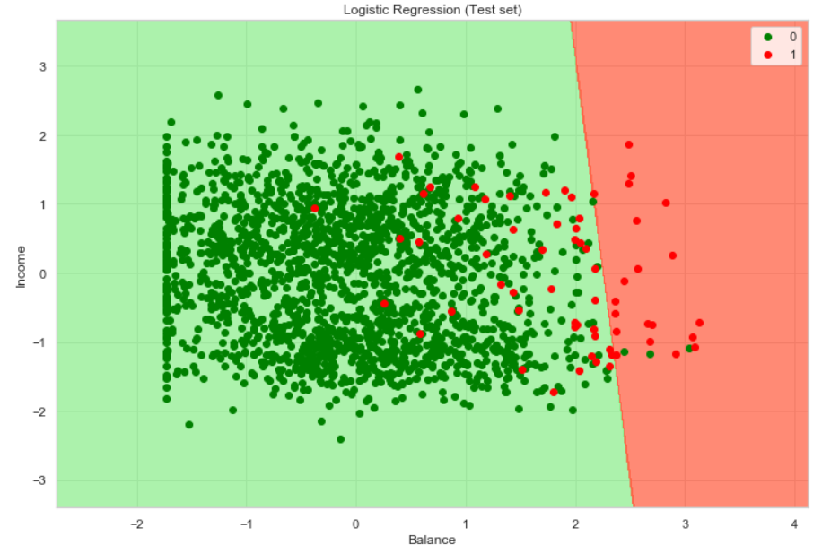
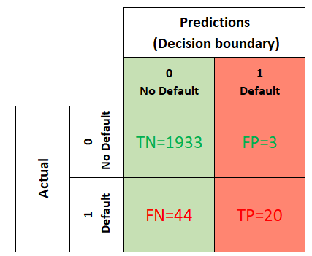
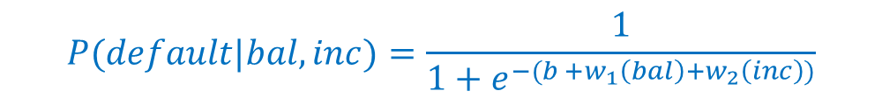
Logistic regression output for credit card default example
$$P(default|bal,inc)=\frac{1}{1+e^{−(b +w_{1}\left(bal\right)+w_{2}\left(inc\right))}}$$
Notes:
The p is our assumed functional form. We use MLE and gradient descent to solve for b and w. After that we make predictions and based on threshold (here y^) we can come up with two different classes.
Pay attention to the scales. Standardization is NOT required for logistic regression. If you use logistic regression with lasso or ridge, then you have to do standarzatoin. How can we incorporate regularization? For ridge we would add the L2 norm of W to the exp(-(b+wx+c(w2)) and etc.
For simple logit regression standardization doesn’t hurt thought. It will speed up the convergence as well.
For much more complicated decision boundaries, non-parametric methods like KNN works better.

Slide 16
Part II
Classification Performance Metrics

Slide 17
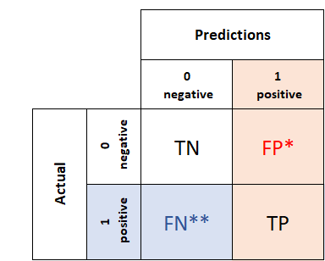
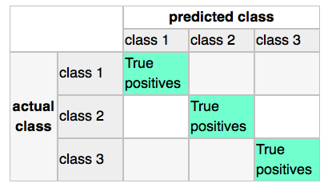
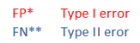
Confusion Matrix
Notes:
summarizes how successful the classification model is at predicting examples belonging to various classes. matrix

Slide 18
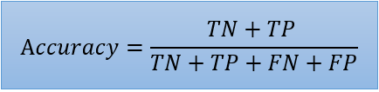
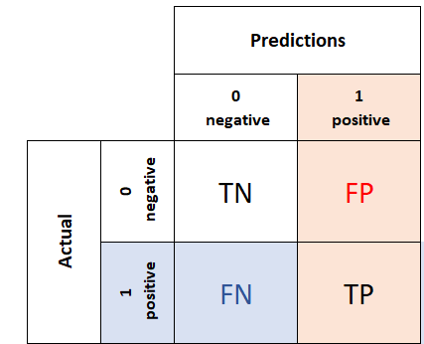
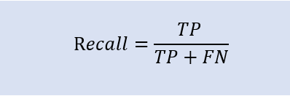
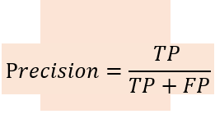
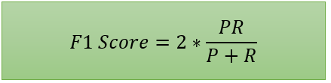
Accuracy, Precision, Recall and F1score
While recall expresses the ability to find all relevant instances in a dataset, precision expresses the proportion of the data points our model says was relevant were actually relevant.
F1 uses the harmonic mean instead of a simple average because it punishes extreme values.
Notes:
Imagine your data is very unbalanced, and there is only 2% default and 98% not default. If you come up with a model that predict not default all the time, then accuracy is 98% right? Haha. For that reason, precision and recall.
Accuracy is good when target variable is balanced.
Error rate = 1- accuracy.
Mathews Correlation Coefficient(MCC): So far we have been looking at metrics which alone can not be used to describe the robustness of the model, but what if I tell you that there is a metric that can pretty much ‘alone’ do the job. Many scientists believe that MCC is the single most informative metric for any binary classifier. MCC(just like other metrics) is calculated using the TN, FN, TP, and FP. MCC is not a biased metric and flexible enough to work properly even in highly unbalanced data.
https://towardsdatascience.com/is-accuracy-everything-96da9afd540d
MCC returns a value between -1 and +1.
A coefficient of +1 represents a perfect prediction,
A coefficient of 0 represents no better than a random prediction,
A coefficient of −1 indicates total disagreement between prediction and observation.

Slide 19
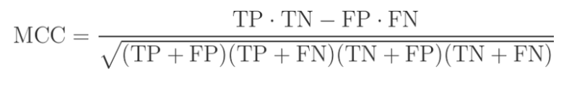
MCC (Matthews Correlation Coefficient)
Accuracy and error rates are misleading for imbalanced data sets.
Precision, recall or even f1 score will not take into account the true negatives (TN)
MCC is one of the most informative metrics for any binary classifier.
MCC returns a value between -1 and +1.
+1 represents a perfect prediction,
0 represents no better than a random prediction,
−1 indicates total misclassification
Notes:
Mathews Correlation Coefficient(MCC): So far we have been looking at metrics which alone can not be used to describe the robustness of the model, but what if I tell you that there is a metric that can pretty much ‘alone’ do the job. Many scientists believe that MCC is the single most informative metric for any binary classifier. MCC(just like other metrics) is calculated using the TN, FN, TP, and FP. MCC is not a biased metric and flexible enough to work properly even in highly unbalanced data.
https://towardsdatascience.com/is-accuracy-everything-96da9afd540d
MCC returns a value between -1 and +1.
A coefficient of +1 represents a perfect prediction,
A coefficient of 0 represents no better than a random prediction,
A coefficient of −1 indicates total disagreement between prediction and observation.

Slide 20
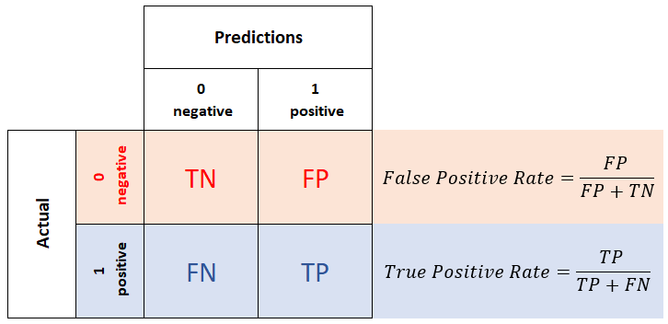
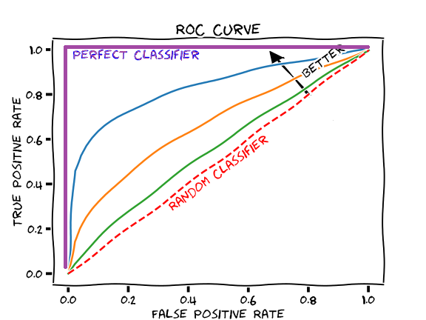


ROC (Receiver Operating Characteristic)
$$ρ$$
FN
TPR
$$ρ$$
FP
FPR
Notes:
If we reduce the threshold, then false negatives will decrease, increasing the recall. Threshold = 0 will give recall = 1.
If we increase the threshold, then false positives will decrease, decrease the FPR or increasing the precision. Threshold =1 will give precision =1
TPR is the same as recall or sensitivity
FPR is also called (1- specificity)
If the threshold is zero, then everything is predicted positive, then TPR and FPR are both 1
If the threshold is 1, then everything is predicted negative, and TPR and FPR are both 0.
The diagonal line y = x represents the strategy of randomly guessing a class. For example, if a classifier randomly guesses the positive class half the time, it can be expected to get half the positives and half the negatives correct; this yields the point (0.5, 0.5) in ROC space. If it guesses the positive class 90% of the time, it can be expected to get 90% of the positives correct but its false positive rate will increase to 90% as well, yielding (0.9, 0.9) in ROC space. Any classifier that appears in the lower right triangle performs worse than random guessing. A simple example: if you use a coin to find the classes, the probability of head is always 0.5. now if you use this probability then for any threshold, below 0.5 you always get TPR=FPR=1 and for any threshold above 0.5 you always get TPR=FPR=0.

Slide 21
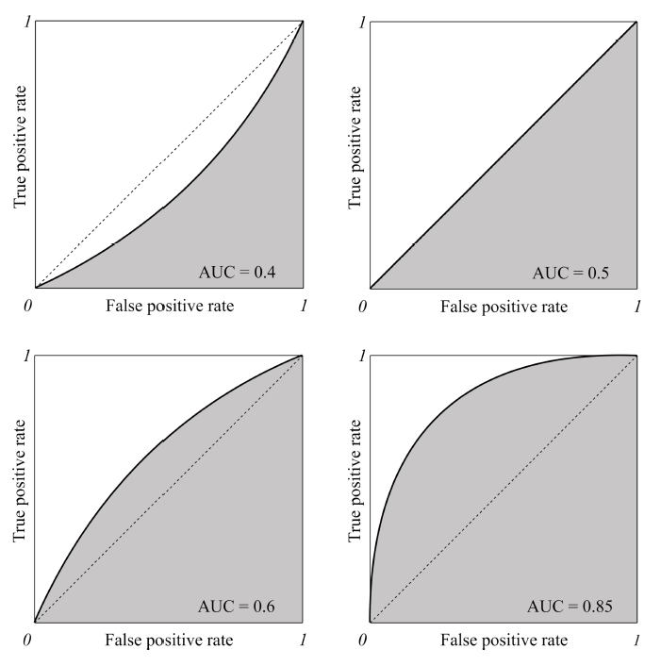
AUC
Notes:
AUC is used for comparing ML models. When the target is relatively balanced.
If it is imbalanced then we use f1score.
ROC curves can only be used to assess classifiers that return some confidence score (or a probability) of prediction. For example, logistic regression, neural networks, and decision trees (and ensemble models based on decision trees) can be assessed using ROC curves.
https://developers.google.com/machine-learning/crash-course/classification/roc-and-auc#:~:text=AUC%20represents%20the%20probability%20that,has%20an%20AUC%20of%201.0.
AUC is desirable for the following two reasons:
AUC is scale-invariant. It measures how well predictions are ranked, rather than their absolute values.
AUC is classification-threshold-invariant. It measures the quality of the model's predictions irrespective of what classification threshold is chosen.
However, both these reasons come with caveats, which may limit the usefulness of AUC in certain use cases:
Scale invariance is not always desirable. For example, sometimes we really do need well calibrated probability outputs, and AUC won’t tell us about that.
Classification-threshold invariance is not always desirable. In cases where there are wide disparities in the cost of false negatives vs. false positives, it may be critical to minimize one type of classification error. For example, when doing email spam detection, you likely want to prioritize minimizing false positives (even if that results in a significant increase of false negatives). AUC isn't a useful metric for this type of optimization.
he AUC of a classifier is equal to the probability that the classifier will rank a randomly chosen positive example higher than a randomly chosen negative example: https://stats.stackexchange.com/questions/132777/what-does-auc-stand-for-and-what-is-it

Slide 22
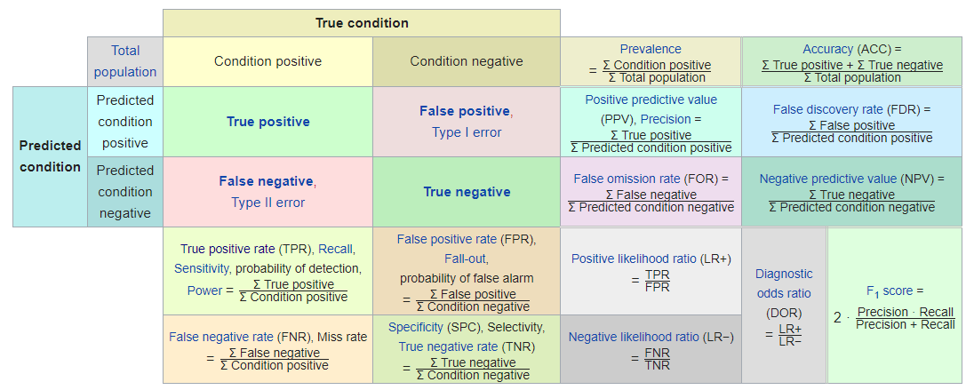
Some other classification metrics
Notes:
Cost sensitivity accuracy: For dealing with the situation in which different classes have different importance, a useful metric is cost-sensitive accuracy. To compute a cost-sensitive accuracy, you first assign a cost (a positive number) to both types of mistakes: FP and FN. You then compute the counts TP, TN, FP, FN as usual and multiply the counts for FP and FN by the corresponding cost before calculating the accuracy

Slide 23


